Slide 1

Covid-19 Vaccines Analysis - Guidelines
The Covid-19 vaccines play a crucial role in controlling the pandemic. Explore the types, efficacy, safety, distribution, and guidelines for vaccination.
By:
Siva Ramana H V
Shalini B
Srimathi S
Raghul Vishal T
Saravanan B

Slide 2

Introduction: Importance of Covid-19 Vaccines
Covid-19 vaccines are essential in preventing the spread of the virus, reducing severe illness, and achieving herd immunity. Let's dive into the details.

Slide 3
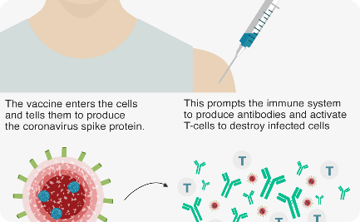
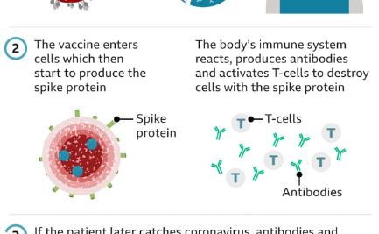
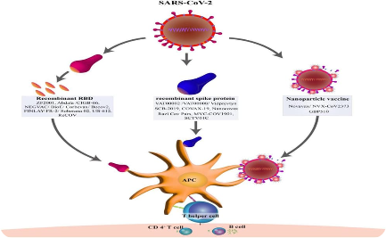
Types of Covid-19 Vaccines
mRNA Vaccines
Viral Vector Vaccines
Protein Subunit Vaccines
Learn about the cutting-edge technology behind mRNA vaccines and their effectiveness in combating the virus.
Discover how viral vector vaccines leverage harmless viruses to trigger a strong immune response.
Explore the protein-based vaccines that contain harmless fragments of the virus to stimulate immunity.

Slide 4
Efficacy and Effectiveness of Vaccines
High Efficacy Rates
Variants and Updates
Herd Immunity
Uncover the impressive efficacy rates of different vaccines and understand what they mean for reducing infection and severe illness.
Learn how vaccines are adapted to combat emerging variants and stay effective in the face of evolving viruses.
Discover how widespread vaccination is key to achieving herd immunity and why it is crucial for ending the pandemic.

Slide 5
Safety and Side Effects of Vaccines
Extensive Trials
Common Side Effects
Understand the rigorous testing process vaccines undergo to ensure safety and efficacy.
Explore the common, mild side effects experienced after vaccination, highlighting their temporary nature.

Slide 6
Distribution and Administration of Vaccines
1
Production and Allocation
Explore the global supply chain and the equitable distribution of vaccines worldwide.
Mass Vaccination Campaigns
2
Learn how countries are organizing mass vaccination centers and ensuring efficient administration.
3
Challenges and Solutions
Identify the logistical challenges faced and the innovative solutions implemented to ensure smooth vaccine delivery.

Slide 7

Guidelines for Covid-19 Vaccination
1
Prioritization
2
Appointment and Documentation
Understand the vaccination priority groups based on risk factors and essential occupations.
Learn how to schedule appointments and what documents to carry when getting vaccinated.
3
Post-Vaccination Protocols
Discover the recommended post-vaccination precautions and observe any possible adverse reactions.

Slide 8

Conclusion and Call to Action
With the Covid-19 vaccines, we have a powerful tool to overcome the pandemic. Stay informed, get vaccinated, and encourage others to do the same!

